Slide 1
IHCDA HOME Homebuyer Program Post-Closing Requirements Session 6
Samantha Spergel
Director of Real Estate Strategic Initiatives and Engagement
Indiana Housing & Community Development Authority

Slide 2
IHCDA’s Mission and Vision
Our Mission
To provide housing opportunities, promote self-sufficiency, and strengthen communities.
Our Vision
An Indiana with a sustainable quality of life for all Hoosiers in the community of their choice.

Slide 3
Agenda
Period of Affordability Determination
Recapture
Resale
Homebuyer Documentation
Lien
HOME Agreement
Homebuyer Completion Reporting
Final Draw Request
Project Monitoring & Notice of Project Completion
On-Going Compliance
Annual Certification of Completion
Refinance and Subordination Requests

Slide 4
Period of Affordability: Recapture v. Resale

Slide 5
What is the Period of Affordability?
The Period of Affordability is the amount of time the unit is required to meet and maintain the HOME requirements.
It is based upon the amount of HOME investment in the property.
HOME Investment | Affordability Period
<$15,000 | 5 Years
$15,000-$40,000 | 10 Years
>$40,000 | 15 Years

Slide 6
What is the Period of Affordability?
The amount of HOME investment to be used in the POA determination, however, is determined by the use of the Buyer Subsidy.
If there is a Buyer Subsidy, then the POA is based on the amount of the Buyer Subsidy.
If there is ONLY a Developer Subsidy, then the POA is based the total HOME investment to the property.
Developers may not elect to use Resale if there is a Buyer Subsidy. Developers are also not allowed to mix Resale and Recapture.

Slide 7
POA requirements
The new owner must maintain residency throughout the POA
Yearly certification required to be submitted to IHCDA
Unit must be primary residence
Non-compliance will trigger full repayment of the total HOME investment to IHCDA from the developer
I.E. Buyer converts unit to rental, Air BnB, home is sold during POA but the recapture/resale provisions were not enforced.
No income certification after initial closing

Slide 8
Recapture and Resale Triggers
If any of the following occurs during the POA, then the Recapture/Resale Provisions are triggered:
Homebuyer transfers or conveys the property by deed, land contract
Foreclosure proceedings are commenced against the property
The Property is transferred by an instrument in lieu of foreclosure, or,
The title to the property is transferred from the homebuyer through other involuntary needs

Slide 9
Recapture
“Sell to anyone, for any price, but pay back the subsidy”
Requires use of HOME for Buyer subsidy
Amount of HOME on Lien and length of POA is based on Buyer Subsidy only
Example: Lien is $25,200, POA of 10 years

Slide 10
Recapture Provisions
The owner may sell the unit to whomever they want at whatever price the market will bare. LRCA is released upon sale.
Upon sale, the buyer must pay the Buyer Subsidy back to IHCDA.
Amount to be paid back is dependent upon:
Forgiven Ratio
Net Proceeds
No right of first refusal during POA

Slide 11
Recapture Provisions – Forgiven Ratio
The amount of the buyer subsidy will be reduced by the “forgiven ratio” – by dividing the number of full months that the owner occupies the property as its principal residence by the total number of months in the POA.
Example: $25,000 Buyer Subsidy; POA of 10 Years. Buyer lived in unit for 4.5 Years.
54 months of residence
120 total months under POA
Ratio is .45
$11,250 to be paid back to IHCDA from owner upon sale

Slide 12
Recapture Provisions – Net Proceeds
The amount to be recaptured is also limited by “Net Proceeds”.
Net Proceeds are the sales price (-) superior loan repayment (other than HOME) and closing costs.
Example: HOME unit sells for $250,000 - $150,000 (Mortgage) = $100,000 net proceeds.
If there are not net proceeds, the amount to be recaptured is $0 and the HOME loan to the owner is satisfied and can be released upon sale.
The amount to be paid back to IHCDA cannot exceed net proceeds.

Slide 13
Resale
Under IHCDA policy, used when no buyer subsidy is given to the homebuyer
Other PJs may have policy to always require Resale – this would be the TOTAL HOME investment (buyer subsidy + development subsidy)
POA is determined by total HOME investment

Slide 14
Resale – what happens if the home is sold during POA?
The buyer must be marketed to, and sold ONLY to a low-income buyer (at or below 80% AMI)
Sales price must be affordable and is set by IHCDA – must ensure the PITI is below the 29% front end ratio and 41% back-end ratio
IHCDA will determine a fair return to the owner and determine the maximum sales price
The new buyer will assume the lien and must live in the property for the remainder of the POA

Slide 15
Post-Closing Documentation

Slide 16
Documentation required
Four documents are required within 30 days of sale:
HOME Agreement
LRCA
Principal Residence Certification
Homebuyer Completion Report
HOME Agreement and LRCA are required by HUD – see CPD notice 12-003
Homebuyer Completion report is the report IHCDA directly enters into the HUD IDIS system for final reporting on the project

Slide 17
Home Agreement & Principal Residency
The HOME agreement is to ensure that all parties are aware of the provisions related to the LRCA and the HOME requirements (principal residency requirement, POA).
Developers will receive a fillable Word Doc in their award packet
Not required to be recorded – must be signed by both Developer and Homebuyer(s)
Principal Residency Certification certifies homebuyers understand HOME residency requirements
Only signed by homebuyers. Does not need to be recorded.

Slide 18
Lien and Restrictive Covenant
Recorded version of LRCA must be submitted
Let IHCDA know if your Recorder’s Office has margin limitations – we can make adjustments
Recapture LRCA included in the Award Packet
If resale is triggered, IHCDA will send that version to you
The POA starts when the entire project has been monitored and closed in the IDIS system. More on this later.

Slide 19
Homebuyer Completion Reporting
This replaces other close-out forms that were previously required.
Three sections of the Form:
Activity Information
Financial Structure of Activity
Household Characteristics
Must be filled out per unit

Slide 20
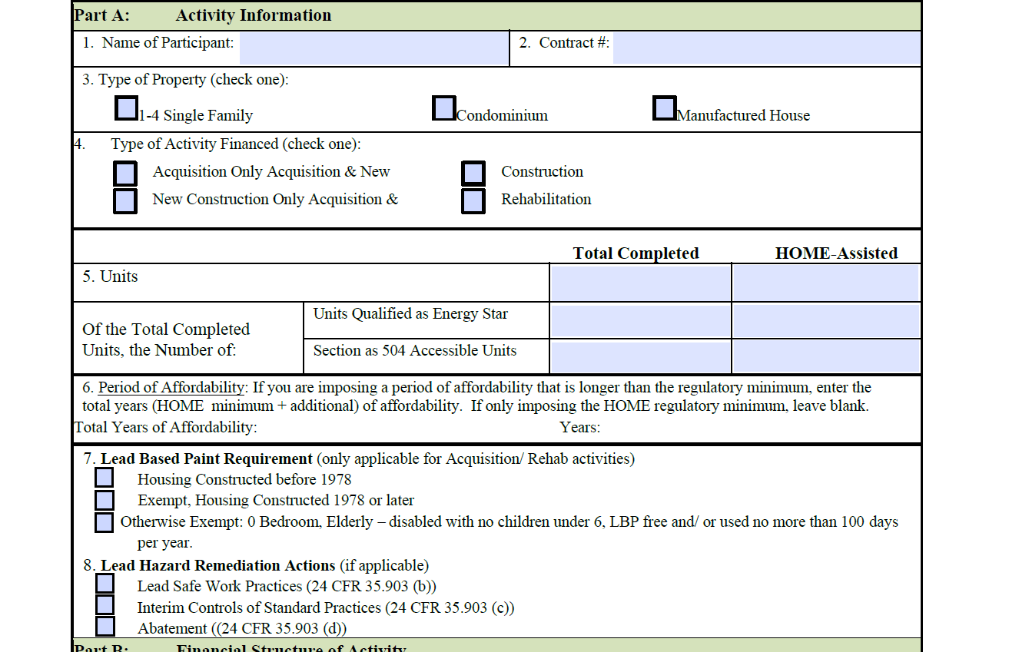
Homebuyer Completion Reporting

Slide 21
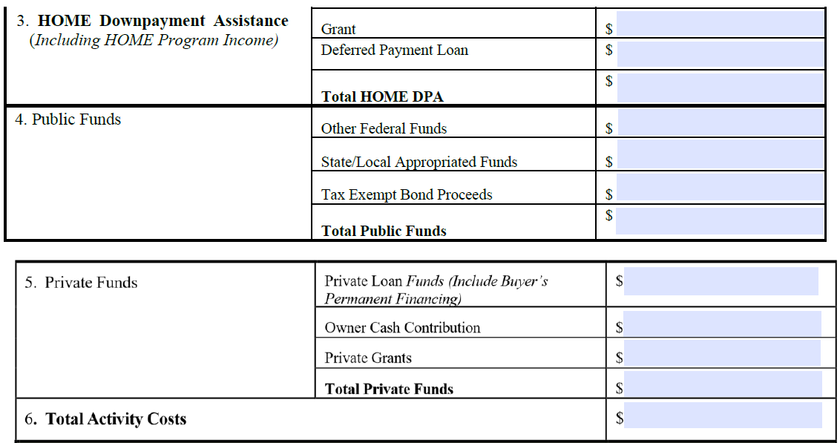
Homebuyer Completion Reporting

Slide 22
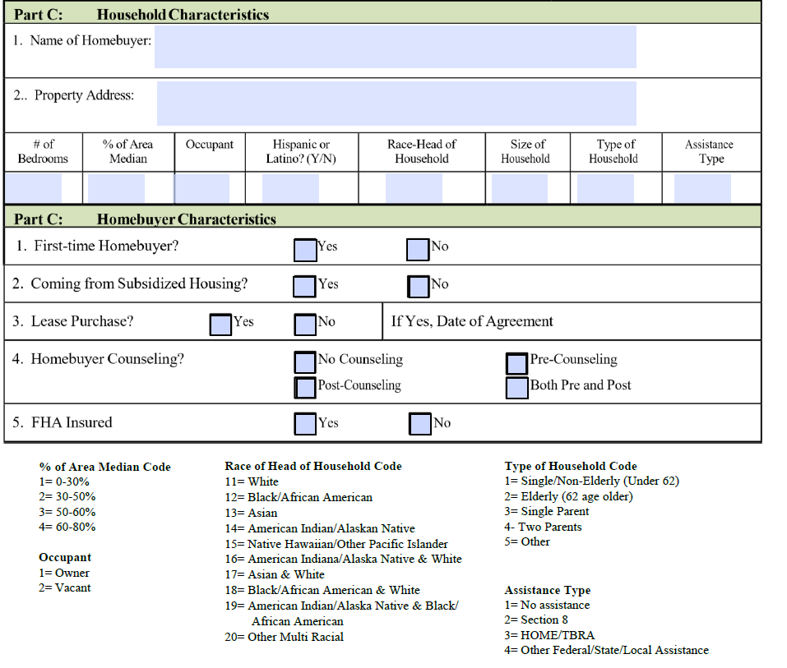
Homebuyer Completion Reporting

Slide 23
Project Monitoring, Final Draw Request and Notice of Project Completion

Slide 24
Final Project Closeout Monitoring
Once all units have been sold and the post-closing documents have been submitted, the project will be added to the RED Compliance queue for closeout monitoring.
All recipients are required to review RED Compliance Congratulations on Your Award located at: https://www.youtube.com/watch?v=AUlm72OFO9E for a high-level overview of what is required for closeout monitoring.
All Awards will receive at least one (1) final closeout monitoring.

Slide 25
Final Project Closeout Monitoring
IHCDA will hold the final $5,000.00 of each award until the final closeout monitoring has been successfully completed.
At the time of final monitoring, recipients must provide documentation via OneDrive of all beneficiary files.

Slide 26
Documentation required for Closeout Monitoring
Beneficiary Documentation
Compliance Form #47- OOR/Homebuyer Income Certification Form
Compliance Form #23- Income Certification Questionnaire to be completed by all adult household members.
Compliance Form #21- Student Status Verification to be completed by all adult household members.
Verification of 2 consecutive months proof of income for all adults or current award letter for unearned income.
Verification of 6 months assets for all adults.
Unit/Award Specific Documentation
Construction Contract(s)
Section 3 HUD Form 60002
Federal Contract Provisions
Release of funds letter
Proof of Performance Bond for the project (if applicable)
Subrecipient Agreement (if applicable
Verification of MBE/WBE/Veteran Owned Solicitation.
Proof of insurance, builder’s risk and property insurance through the P.O.A.
Procurement standards
Fair Housing and Equal Opportunity Documentation
Lead Based Paint disclosure (if applicable)
Affirmative Fair Housing Marketing Plan (if applicable)
URA (if applicable)
Property acquisition (if required)

Slide 27
Final Draw Request
Compliance will inform the developer when the final draw request may be made.
$5,000 retainage may then be claimed.
It is strongly encouraged that claims for retainage be submitted prior to contract expiration and before final monitoring. The Financial Operations team should deny the claim.
Once the developer is allowed to claim the retainage, the same claim can be resubmitted through IHCDA and should be processed.
Please note that claims can take up to 30 days to process.

Slide 28
Notice of Project Completion
The POA cannot start until the entire project is closed in IDIS – this means all units sold, the project has completed its final monitoring and all eligible claims have been paid.
Once the project is closed, IHCDA will issue a notice to the buyer, once the completion date is known, which will serve as an amendment to the HOME Homebuyer agreement.

Slide 29
Post-Closing Compliance

Slide 30
Annual Certification of Compliance
Homeowner must live in the HOME-assisted unit as their primary residence throughout the POA.
NOTE: There is NO income requirement under HOME Homebuyer after closing.
IHCDA must receive yearly the “Homebuyer Activity Annual Certification of Compliance” throughout the POA.
IHCDA will be providing more guidance on this later on how to submit the form and the timing of submission.

Slide 31
Refinance and Subordination
During the POA, the homebuyer may refinance their first mortgage (the non-HOME debt) and request a subordination of their HOME loan.
IHCDA will allow the refinancing to allow to owner to either obtain a lower interest rate, or, if there is sufficient equity, to take cash out for repairs or other catastrophic expenses.
Any cash out refinancing to the property must result in a total loan-to-value ratio of 90% or less.
Total indebtedness may not exceed the value of the property; predatory lending and non-confirm loans are not permitted.

Slide 32
Refinance and Subordination
The following must be submitted to IHCDA as part of the request:
Two bank statements
Copy of the LRCA and any amendments or addendums
Appraisal
Good Faith Estimate
1008
Estimated closing date
Name of lender
Amount of new loan
Homebuyer refinance/subordination request form
Current and new rate if applicable
Current and new monthly payments if applicable
IHCDA staff may request additional information and documentation as part of their review.

Slide 33
Refinance and Subordination
If approved, IHCDA’s Legal Department will execute the Refinance/Subordination Agreement.
This will be executed between IHCDA, the borrower and the lender.
Refinancing does not alter the POA on HOME.
IHCDA recommends that borrowers or lenders reach out to IHCDA at least two weeks prior to closing.

Slide 34
Upcoming Training – NONE!
You’ve successfully completed this series!

Slide 35
Any Questions?
Samantha Spergel, Director of Real Estate Strategic Initiatives and Engagement
sspergel@ihcda.in.gov

