Slide 1

USDA Foods: Forecasting for the Future
By: Carole Erb, J.T.M. Food Group
Notes:
Greetings, everyone, and thank you for being here today.
I appreciate the invitation to contribute to the conversation on forecasting and
I’m humbled to share what I hope to be points of interest on the topic.
Many of you know Bob Rybolt and Alison Jordan with J.T.M. and I am enormously blessed to have been a part of our team for 19 years now.

Slide 2


From a Processor’s Perspective…
The importance of forecasting to the supply chain and cost-effective procurement
The impact of good forecasting
Regulations pertaining to Months on Hand Inventory
The results of good managing practices
Communicate, communicate, communicate!
Notes:
What I plan to discuss in the next few minutes are:
The importance of forecasting to the supply chain and cost-effective procurement
The impact of good forecasting
Regulations pertaining to Months on Hand Inventory
The results of good managing practices
Communicate, communicate, communicate!

Slide 3
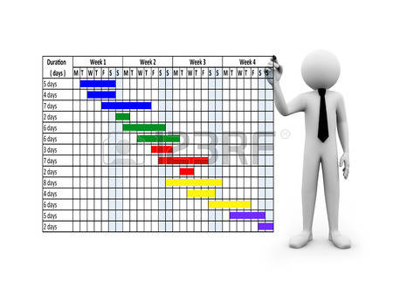
Forecast
To calculate or predict (some future event or condition) usually as a result of study & analysis of available pertinent data.
Notes:
As Mary has already discussed, forecasting involves calculating and predicting.
It’s hard work. It’s important work. And speaking for all Processors, your work is very much appreciated.

Slide 4
What are the benefits of forecasting?
Cost savings are realized as bids become more desirable and competitive
Assists in ensuring a steady supply of finished goods
Just-in-time inventory is carried at the manufacturer and distributor
Reduces excess inventory
  USDA FD-064 (revised)
  Cost of capital decrease thus resulting in better pricing for the end user
Notes:
Again, I’m speaking from a Processor’s perspective and from where I sit, there are several benefits to you as you perfect and communicate your forecasting needs.
Cost savings are realized – your bids become more desirable and competitive
Assists in ensuring a steady supply of goods
Just-in-time inventory is carried at manufacturer and distributor
Reduces excess inventory
There are regulations that Processors are held accountable to relation to working with USDA Foods
And as we reduce excess inventory, costs of capital decrease, resulting in better pricing for YOU, the end user

Slide 5

Why should you forecast?
Improve budgeting
Fill rates for orders increase
Delivery schedules are met
Reduces need to make menu changes
Save time in the long run!
Notes:
Another way of looking at this topic is to say this work may not see immediate results.
But I am convinced you will see long-term benefits as a result of your efforts.

Slide 6

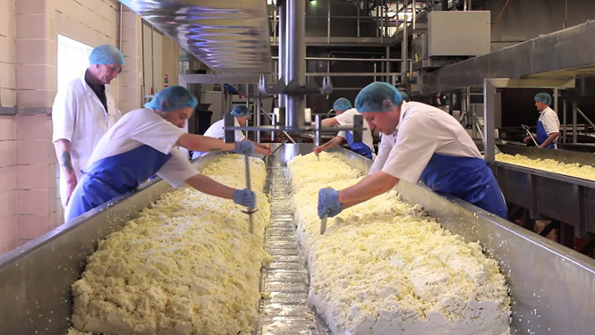
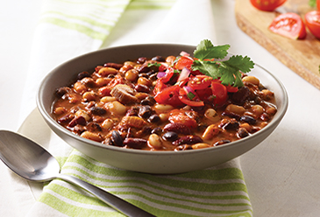
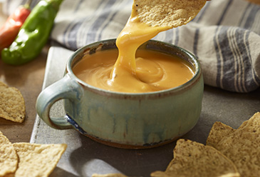
Raw Material AND Finished Goods
Notes:
Now that I’ve talked about how important your forecasting efforts are, I want to share that for me, forecasting is critical not only of the end items you will serve but also about the RAW MATERIALS that we accept from your Processing Diversions.
When you elect to send USDA Foods to a Further Processor, that Processor must follow regulations pertaining to the inventory.

Slide 7
FD-064 (revised)
Management of USDA Food Inventories at Processors
“Allowable Inventory” also known as “The 6 Month Rule”
  How do I calculate the Average Monthly Usage?
    Prior SY Usage / 10 months
      16,000# / 10 months = 1,600# is the Average Monthly Usage
    Allowable Inventory
      1,600# x 6 months = 9,600#
Notes:
FD-064 (revised) April 2, 2019, is one of the primary regulations a Processor must be aware of when working with USDA Foods.
This regulation speaks to the “allowable” inventory in raw pounds that I may hold for an individual Recipient Agency, or for a State Agency when considering my liability for all the districts in that state.

Slide 8

Months on Hand Calculation
Today’s Balance/Average Monthly Usage
18,000# / 1,600# = 11.25 MOH
Notes:
Another way of looking at the calculation is to take your balance for that USDA Foods code and divide it by the AMU.

Slide 9

What causes excess inventory?
Lack of Forecasting
Forecasting errors
  Non-existent SKUs
Insufficient lead time
Shortages
Notes:
Forecasting begins with the menu.
What causes excess inventory at the Processor – on paper –
is a lack of forecasting or perhaps forecasting with product codes that no longer exist.
Many Processors have a two to three-week lead times for orders and
shortages can happen for a variety of reasons: everything from labor shortages in our manufacturing plants to accidents along the highway as goods are being delivered.

Slide 10
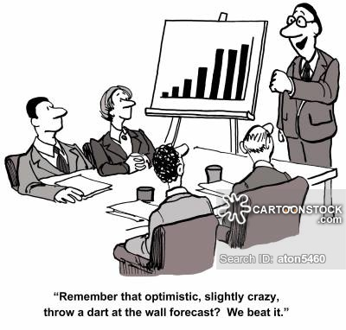
Forecasting is only effective when:
  “You divert what you will use and use what you divert”
Notes:
If I had a T-shirt factory, I would make up t-shirts that say: Divert what you will use and use what you divert.

Slide 11
Things that influence forecasting!
COMMUNICATION!
Recipient Agency
Processor
Broker
Distributor
State Agency
Notes:
Perhaps the most important message today is the reminder to communicate your forecast with all stakeholders.

Slide 12

Forecasting!
Communication is key
Revisit due to revisions!
Look at historical data – but update!
Accountability
Notes:
It is your money; your product.
Don’t hesitate to communicate with the Processor.
This is not a once-and-done project. Revisions will be needed throughout the year.
It’s okay to look back at historical data, but it must be updated with new product code numbers and dependent upon what YOUR awarded distributor has in stock.
We are all accountable for your success.
When you run a fiscally sound program, we all win!

Slide 13
Pulling all the pieces together
Procurement
Acceptability
Communication
Distributors
Accountability
Processors
Pricing/Cost
Brokers
Best Service
State DA
Quality Lead Times
Process/Practices Procedures
Menu Cycle
USDA Foods Ordering Availability
Notes:
With proper forecasting, YOU can pull all the pieces together!

Slide 14

USDA Foods: Forecasting for the Future
Carole Erb
Senior Director, Education Sales
J.T.M. Food Group
caroleerb@jtmfoodgroup.com

